Slide 1
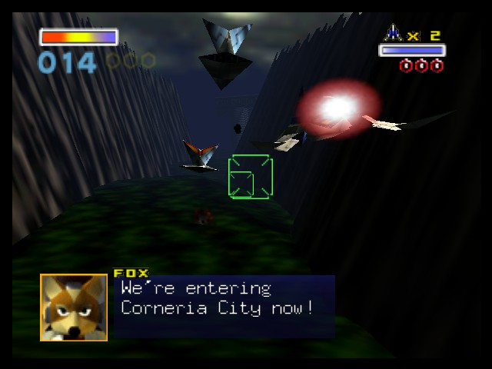
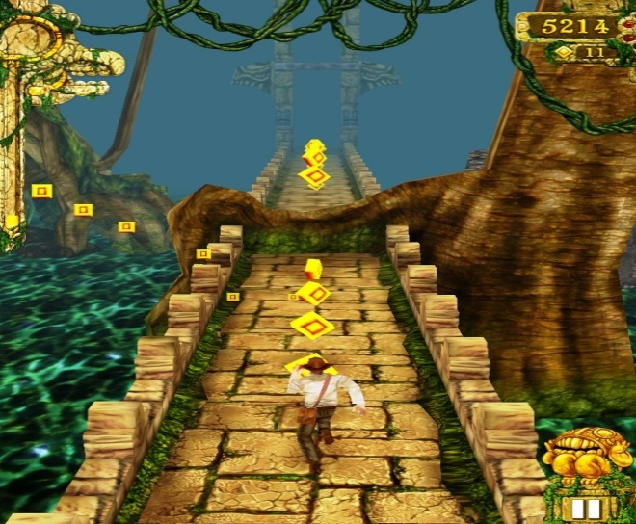
Death-rone
Image from: http://tinyurl.com/qf7gh5j
Image from: http://tinyurl.com/obn3tjs
Notes:
I start off the presentation by giving a quick introduction about myself, and proceed to inform the potential investors about my game, Death-rone (Death Run/De-throne)

Slide 2
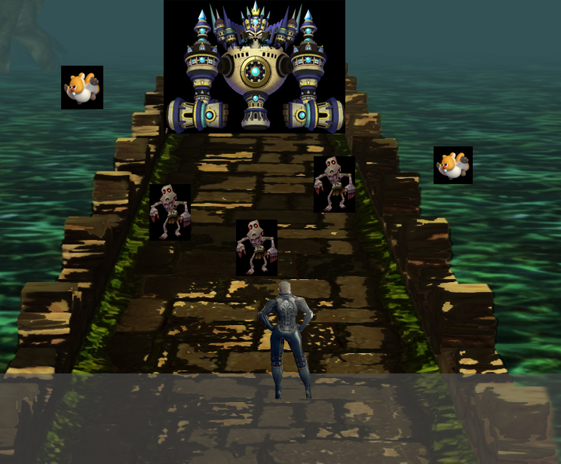
What is it?
Endless runner that has action combat mechanics.
Simple movement and combat controls, intended to be played with one hand
Linear progression with boss battles.
Notes:
I explain what the project is going to consist of, whilst giving the basic idea to investors what the basic fundamentals are which could potentially outshine competition. I would let the investors know that I will go into further detail regarding the concept art.

Slide 3
Why Create this?
Lack of action combat on-rail games on mobile.
Simple to play with one hand.
Mechanics intended to be simple and engaging.
Notes:
I explain briefly about how I wish to create a game that is easy to play with one hand, feels fast and fluid and has linear style progression with combat mechanics. The current lack of true-action on-rail mobile games on mobile is lacking, and action games on mobile generally require a long and steep learning curve that some mobile gamers refuse to learn. ( For Reference, http://tinyurl.com/o3ywx2b)

Slide 4
Target Market?
People who enjoy linear gameplay action.
People who enjoy non-convoluted stories.
Gamers on the go.
Notes:
I would give a brief explanation on the games intended target market. Generally people who enjoy linear gameplay with simple storylines, as well as gamers on the go. I give a quick reasoning behind this, saying that mobile games can achieve compelling storylines, but a major emphasis on addictive gameplay and fun factor works just as well. (reference from http://preview.tinyurl.com/pnwow5s)

Slide 5
What unfair advantage is there?
Simple control scheme for a combat-heavy game.
Levels progress on-rail style, with end boss battle.
Players given a choice to progress in any order.
Notes:
I further emphasize that the gameplay is a crucial part to the game, convenience to play it coming to a close second. I would point out that having a simple gameplay mechanic and learning curve whilst showing off appealing in game aesthetics and control is a factor that can influence your game’s popularity and longetiviity.

Slide 6
Concept Art
Final Boss of the stage
Combination of flying and ground enemies
Player swipes area to cut, or tap to fire projectile, destroying the enemies.
Grey Area: Player movement Area (left/right/jump)
Player has 3 lives, life count determined by current player character’s aesthetics.
Notes:
For this concept slide, I would go into detail and point out each specific element of the concept screenshot shown earlier, primarily what each pointed object and element on the screenshot points towards.

Slide 7
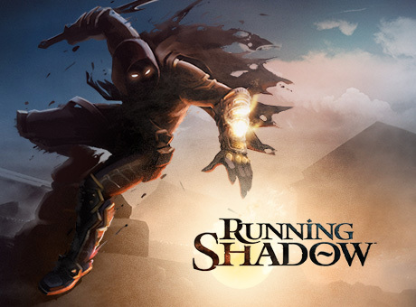
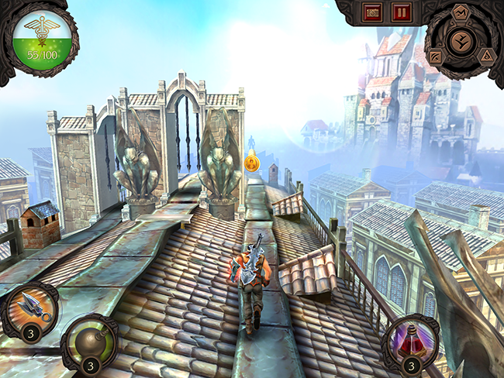
Potential competition?
Running Shadow
On iOS, Android and Steam.
RPG-element.
Notes:
A potential risk here, being associated as a ‘copy’ of another game. I explain the general gameplay of the rival game, and also the platforms its on. However, I criticize that it is not really true action, as the only combat is sliding down or up to attack via quick time events. The gameplay also feels repetitive after a while, trying to persuade the player to use in-game purchases.

Slide 8
Why back it?
Emphasis on simple storyline, simple gameplay.
No advantageous benefits via monetary payments.
Game that anyone can enjoy.
Gameplay would not be annoyingly repetitive, losing customer interests.

Slide 9
How much to invest in?
£ 8000, for the first 4 levels. Done in 5 months time.
Charge £1.99
Include DLC for cosmetics in the future. Price ranging from £ 0.60 to £ 1.50

Slide 10
Appendix
http://androidspin.com/2014/02/06/game-insight-releases-details-upcoming-running-shadow-game/ - Running Shadow

